Slide 1
Personal Software ProcessSM
for Engineers: Part II
Using the PSP

Slide 2
Lecture Topics
Working on a team
What is the TSP?
Launching a TSP team
Working on a TSP project
Next steps
Concluding comments

Slide 3
Working in Teams
Successful teams are both satisfying and rare.
Although many teams come close to meeting their product and business goals, they often do so at the expense of the team.
“There is something magical about an effective team.
  It has an ethic, an attitude, and an energy that permeate everything it does.
  The teammates support one another.
  They intuitively know when and how to help.
  They rally around at just the right time.
  The members are part of a common effort.
  They have a sense of belonging and a feeling of camaraderie.”
- Introduction to the TEAM Software Process, Watts Humphrey
This is what we call a “jelled team.”

Slide 4
Jelled Teams
Jelled teams do the best work.
The objective of the TSP is to build and maintain jelled teams.

Slide 5
Complex Intellectual Work
To do complex and high-quality intellectual work, software professionals must
  truly understand the problem
  find the problem an interesting challenge
  want to solve the problem
  have the flexibility to solve the problem their own way
Software developers like to work this way.
It is highly rewarding to work on a team that
shares common goals
works cooperatively to meet its goals

Slide 6
How Successful Teams Evolve
The ability of a team to effectively work together develops over time.
Teams generally begin with
  diverse goals
  no clear sense of responsibilities
  vague ideas about the product to be built
  varying approaches to the work
In time, team members may converge on a common understanding of these factors.
Only then can they do their best work.

Slide 7
Requirements of Team Members
While skilled members are essential, technical skills alone are not enough.
High-performance teamwork
  is interdependent
  involves shared commitment
To work this way, the team members must
be personally disciplined
understand their own abilities
make realistic commitments

Slide 8
What is the TSP?
The TSP is a framework and a process structure for building and guiding engineering teams.
The TSP contains
  a team-building process that builds shared goals, commitments, and cohesion
  a team-working process that guides the team’s engineering processes and practices
A prerequisite for TSP teams is mastery of the software engineering and process skills taught in the PSP course.

Slide 9
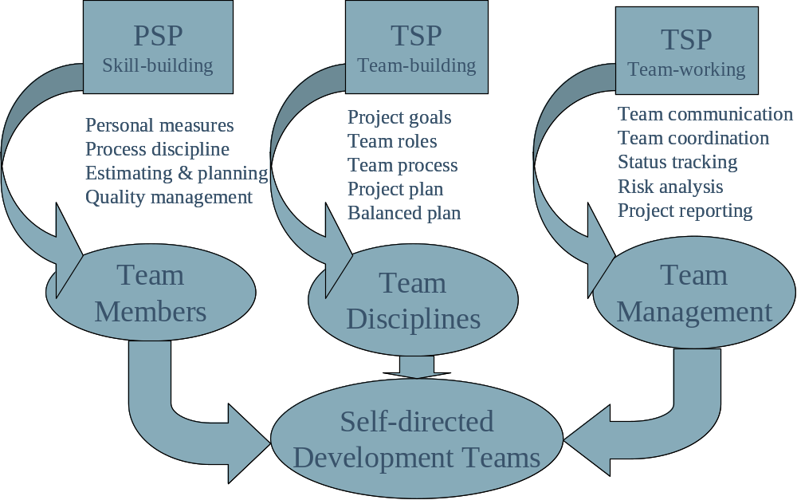
Building Effective Teams with the TSP

Slide 10
What Does the TSP Do?
The TSP establishes an environment that builds, develops, uses, and supports self-directed teamwork.
A self-directed team
sets its own goals
establishes its own roles
decides on its own development strategy
defines its own processes
develops its own plans
measures, manages, and controls its own work
Self-directed teams are jelled teams and they do the best work.

Slide 11
Management Support
Management will agree to you and your team mates working as a self-directed team as long as you
strive to meet their needs
regularly report on your work
convince them that your plans are sound
do quality work
respond to changing needs
come to them for help when you need it
While this is not hard for you to do, it takes
skill
disciplined work
guidance and support

Slide 12
Building Needed Skills
The PSP shows you how to
  measure and manage your personal work
  use data to make sound plans
  manage the quality of your work
  produce quality products on predictable schedules
With the TSP, you use these skills to convince management to support self-directed teamwork.
The TSP launch starts you on this road.

Slide 13
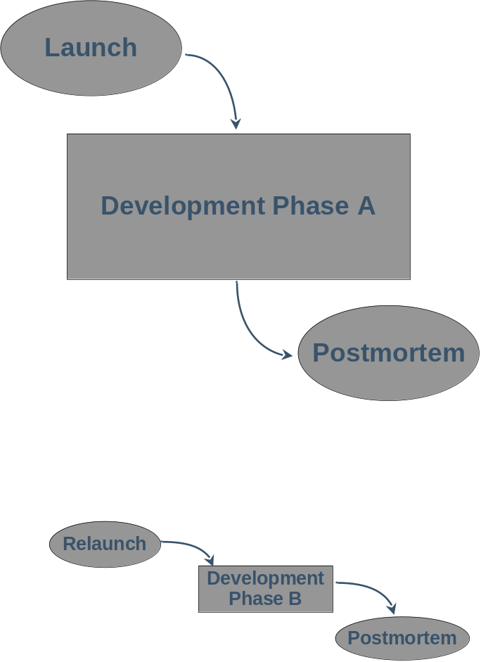
TSP Structure and Flow
A TSP launch kicks off each major project phase.
The team builds a common understanding of the work and the way to do it.
The members produce plans to guide their work.
Subsequent phases kick off with a TSP relaunch.

Slide 14
The TSP Launch -1
The TSP launch is a four-day workshop involving the team and management.
The team leader and all team members participate.
The launch workshop is not a course; it is part of the project.
Launch workshops are planned and tracked.

Slide 15
The TSP Launch -2
The TSP launch performs essential tasks.
  Without the launch, these tasks are not generally addressed until well into the project, if then.
  Then it is often too late to prevent problems.
  These late-discovered problems usually cause delays.
The launch workshop accelerates team building. It builds
a common understanding of the job
agreement on how to do the work
commitment to a team plan
management support for the plan
the products needed to get management support

Slide 16
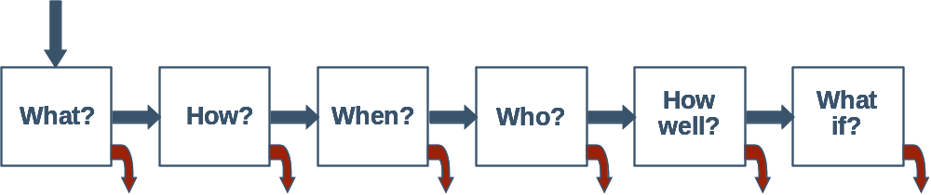
The TSP Launch Products
Business needs
Management goals
Product requirements
Team goals
Conceptual design
Planned products
Size estimates
Team strategy
Team process
Task hour plan
Schedule plan
Earned-value plan
Team roles
Task plans
Detailed plans
Quality plan
Risk evaluation
Risk mitigation plans
Alternate plans
Notes:
Commitments are often made when little is know about a project.
“If you can’t plan early, plan often”
- Humphrey
A plan is a snapshot of what needs to be done.
Based on what you know at the time.
Should be revisited when new information is gained.
Adjustments can be made if early warning is given.
The intent is not to continuously reset the end dates, but to continuously reexamine the amount of work left to do to reach the end date.
The TSP development strategy encourages
incremental development
iterative development
multiple builds or cycles
working ahead

Slide 17
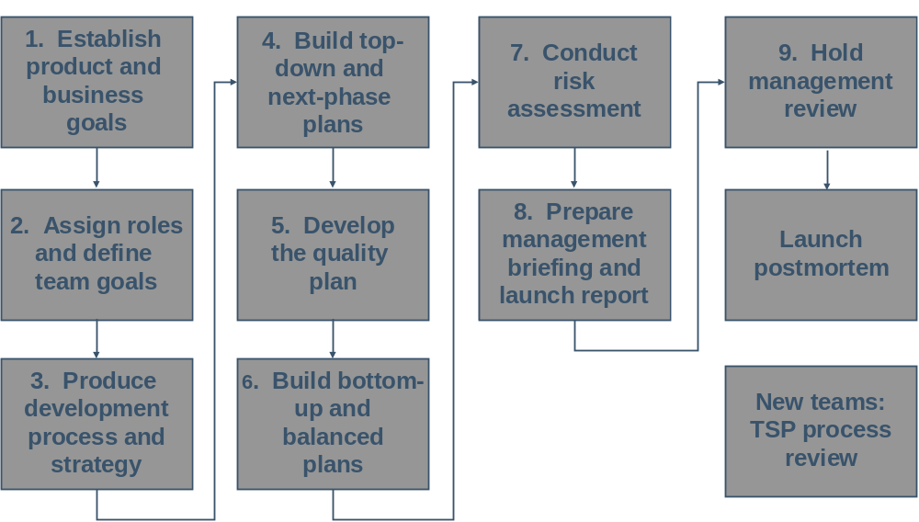
The Launch Process Meetings
Day 1
Day 2
Day 3
Day 4

Slide 18
TSP Launch Meeting 1
Meeting 1 provides the developers the information they need to produce their plan.
Meeting 1 is typically led by the TSP coach.
The agenda is as follows.
Sponsor: opening comments
Coach and attendee introductions
Coach: review of meeting objectives and agenda
Senior management: project objectives
Marketing/customer: project requirements
Questions and discussion

Slide 19
Meeting 1 Strategy -1
Management usually describes the needed products and schedules.
While this “solution” is usually aggressive, it only represents one possible way to do the job.
The team must understand management’s true needs to address them.
Do not even imply that you think management’s objectives are unrealistic.
Your attitude should be: “If that is what management wants, we will do our utmost to do it.”

Slide 20
Meeting 1 Strategy -2
In meeting 1, the team should ask enough questions to understand what management needs.
In meetings 2 through 8, the team will strive to produce a plan that meets these needs.
Only the team, the team leader, and the TSP coach attend these meetings.
Then, in meeting 9, the team will meet with management and other invited parties to review the team’s plan.

Slide 21
TSP Launch Meeting 2
Meeting 2 has two objectives.
to obtain agreement on the team’s goals
to establish the team member roles
The team leader typically leads the team through the goals discussion, with help from the TSP coach.
You start with management’s stated goals.
Then you review the implied but unstated goals.
Next, you agree on the team’s goals.
Finally, you define goal measures.
Once you agree on the goals, the team leader and coach guide the team through team role selection.

Slide 22
The TSP Roles -1
The TSP roles establish responsibilities for team operation.
The development roles are
  Customer interface manager – focal point for requirements and customer-related issues
  Design manager – establishes design standards and guides the design work
  Implementation manager – defines the implementation standards and handles implementation issues
  Test manager – ensures that test issues are properly considered and handles test planning and coordination

Slide 23
The TSP Roles -2
The TSP support roles are
  Planning manager – helps the team maintain, track, and report on the plan and plan status
  Process manager – guides the process definition work, handles PIPs, and monitors process data
  Quality manager – reviews process and product quality and monitors team inspections
  Support manager – ensures that proper support tools and aids are available and handles support issues
The team assigns additional roles for security, safety, usability, and so forth if they are needed.

Slide 24
The Team Leader Role
The team leader typically does not take any team roles.
The team leader’s responsibilities are to
  Provide team leadership – sustain motivation, prioritize the work, guide team members
  Maintain team communication – run weekly meetings and communicate management needs and actions
  Obtain resources – get needed staffing and protect team members from non-project demands
  Report to management – inform management about team progress and issues and get help when needed
On any but very small teams, the team leader does not have time to do much if any development work.

Slide 25
Meeting 2 Products
In meeting 2, the team produces and documents two products.
The team goals
define each goal
decide on goal measures
assign member responsibility for tracking the goal
compare the team’s goals with management’s objectives
The team roles
the member assigned to each team role
any additional roles that the team feels are needed

Slide 26
TSP Launch Meeting 3
In meeting 3, the team
defines the products to be produced
agrees on a product conceptual design
develops a project strategy
defines the development process
With the coach’s guidance
the team leader leads the team in defining its products
the team leader also leads the team in establishing the
development strategy
the design manager leads the effort to produce the
conceptual design
the process manager leads the team in defining its
development processes

Slide 27
Meeting 3 Products
In meeting 3, the team produces and documents four products.
The list of the project’s planned products
The product conceptual design
The team’s development strategy
The team’s development process

Slide 28
TSP Launch Meeting 4
In meeting 4, the team develops its top-down plan for the entire job.
Whether the job lasts 5 weeks or 5 years, the team’s top-down plan covers final product delivery.
Plan duration is defined by the duration of the team’s commitment.
For a five-year project, if the commitment is for
one phase, the team makes a one-phase plan
if the commitment is for five years, the team makes a five-
year plan

Slide 29
Meeting 4 Agenda
In meeting 4, teams first develop a detailed product size estimate.
Then, based on their defined process, the team members define the job’s tasks and estimate the time for each.
During meeting 4, the team often discovers that it cannot meet management’s needs with the available resources.
The team then devises alternate plans with varied mixes of resource, function, and schedule.

Slide 30
Meeting 4 Products
In meeting 4, the team produces the following products.
Product size estimates
Task-hour plan
The schedule plan
The earned-value plan
One or more alternate plans if needed

Slide 31
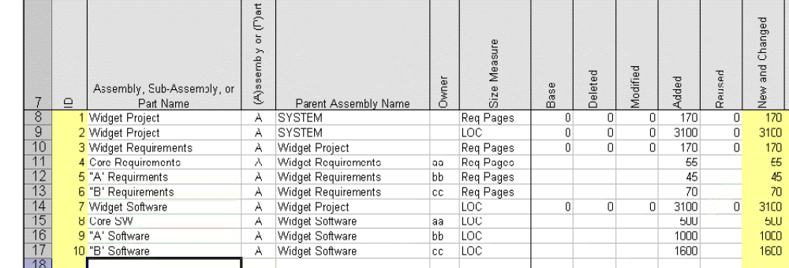
Project Size Estimate
TSP teams typically document their size estimates in a TSP support tool.
The size estimates look like the following:

Slide 32
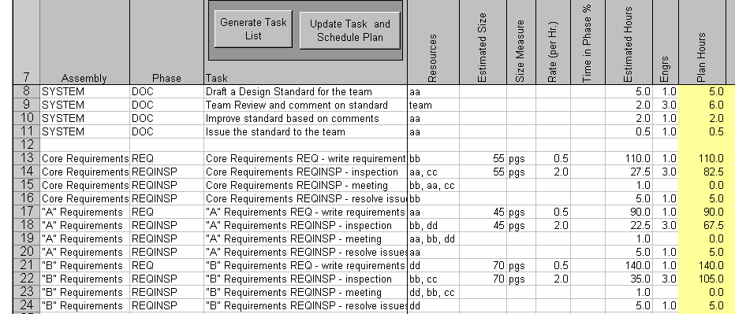
Team Task and Resource Plan
The task list includes the product assembly, process phase, task, team assignment, estimated size, and development time.

Slide 33
TSP Launch Meeting 5
In meeting 5, the team makes its quality plan.
The members estimate the defects injected from historical defect-injection rates and planned phase times.
They also use historical yield data to estimate defects removed by phase.
The team discusses and agrees on the quality management strategy and plan.
The meeting 5 product is a quality plan with delivered product defects and projected defects injected and removed by phase.

Slide 34
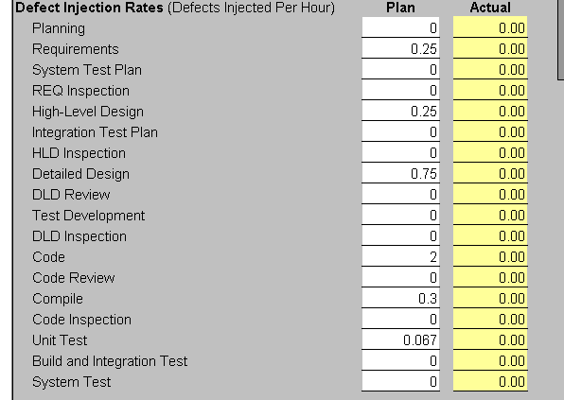
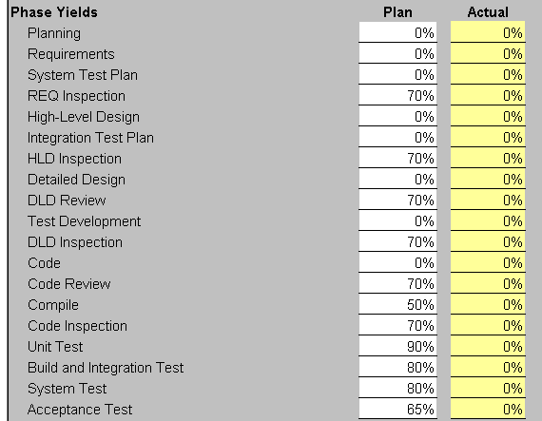
Quality Plan
To make the quality plan, the team enters defect-injection and yield data and the TSP support tool calculates the defects injected and removed by phase.

Slide 35
TSP Launch Meeting 6
In meeting 6, the team members make personal plans for the next plan period – typically three to five months.
The team planning manager leads this effort, under the guidance of the TSP coach.
who will handle each task
member plans for the assigned tasks
consolidated team plan
The team reviews the consolidated plan and rebalances team-member workload if needed.
The meeting 6 products are
balanced team member plans
a consolidated overall team plan and alternate plans

Slide 36
TSP Launch Meeting 7
In meeting 7, the team assesses the plan’s perceived risks.
A risk may or may not happen while an issue is certain to happen.
The team decides which risks to track and manage and what mitigation plans are needed.
The meeting product is a list of the risks with each
rated on likelihood
rated on severity
assigned to a team member for tracking

Slide 37
TSP Launch Meeting 8
In meeting 8, the team prepares its meeting 9 plan presentation to management.
The typical meeting 9 agenda is as follows.
A brief summary of the meeting conclusions
A review of the launch process
The summary of the team’s and management’s goals
The team member role assignments
The development strategy and process
The plan and principal alternate plans
The quality plan
Risk evaluation and mitigation
Questions and discussion

Slide 38
Meeting 8 Strategy
The team leader typically presents the plan with team members participating as the team chooses.
It is important to provide summary plan information but to also have the details available if requested.
The products of meeting 8 are
overheads for the meeting 9 presentation
handout copies of the plan materials
the likely management questions and the team’s agreed
responses
a list of the help needed from management to implement
the plan

Slide 39
TSP Launch Meeting 9
The team, team leader, coach, management, and invited visitors attend meeting 9.
The meeting purpose is to
describe the team’s plan to management
answer management’s questions
get management’s approval of the plan or selected
alternate
identify needed actions, who will take them, and when
The meeting product is typically an approved plan or the actions needed to get approval.
When management does not agree with any of the plans, they usually decide to reconsider their needs.

Slide 40
Meeting 9 Strategy
It is advisable to start meeting 9 with a statement like: “We could not precisely meet your requirements but we have developed several alternate plans that we believe come reasonably close.”
This tells management what to expect and allows them to listen rather than to poke at every potential plan weakness.
The team should explain how the plan was made.
the data used
the assumptions made
where they had to guess

Slide 41
TSP Launch Postmortem
The launch postmortem is to
consolidate the plan and launch data
review the launch process and produce PIPs
discuss open issues and agree on how to handle them
The final launch steps are to
assign responsibility for the project notebook (often the
process manager)
assign responsibility for handling the PIPs
file launch data in the project notebook
submit the launch data to the SEI

Slide 42
Working on a TSP Project
Once you have management support to launch a TSP team, you need to keep that support.
This requires that you and your teammates do five things.
  Follow the process you have defined.
  Maintain the individual and team plans.
  Manage product quality.
  Regularly track and report your progress.
  Continually demonstrate high performance.

Slide 43
Following the Process -1
Even though you defined the process yourself, it will likely be a challenge to follow it consistently.
Recording time, size, and defect data takes little time but is easy to forget.
When you do forget, just enter your best estimate.
Without good time, size, and defect data, you cannot precisely manage the project schedule or product quality.
History demonstrates that, without precise management, software projects usually fail.

Slide 44
Following the Process -2
The key to following the process is to recognize that the longer you do it, the better you will get at it.
What is most exciting is that, as your process fidelity improves, so will your job performance.
This in turn will improve
your pride in your work
the quality of your products
your credibility with management
how management values you as an employee

Slide 45
Maintaining the Plan
Challenging and dynamic fields like software face constant change.
As we develop products, we learn more about what is needed, how to build it, and how to improve it.
To incorporate this continual learning, we must update our plans.
Keep old plan copies, but don’t hesitate to change the plan.
If you don’t, you will not be able to track and report on the work.

Slide 46
Tracking Product Quality
The PSP data provide a wealth of information that help you
manage the quality of your work as you do it
assess and improve the quality of each process step
evaluate the quality of your products as you build them
decide which products have marginal quality and should
be reworked
The most useful quality measures are yield, A/FR, review rates, defects/size, and PQI.

Slide 47
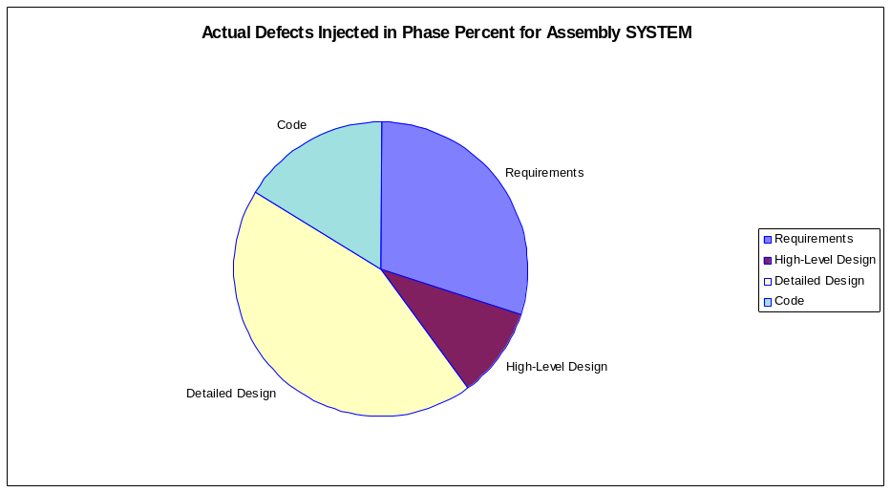
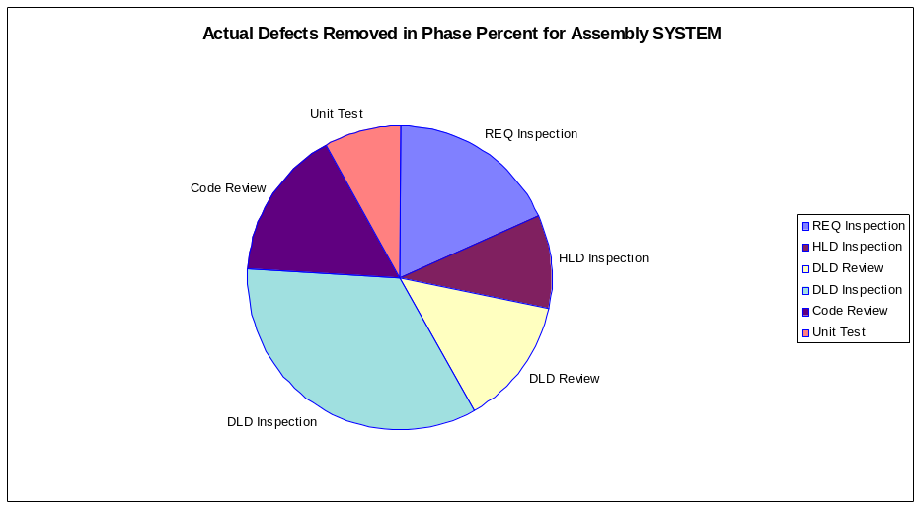
Defect Data by Phase
With the PSP data, TSP tools can display lots of useful information.
One example is the percentage of actual or planned defects injected by phase.
Another is the defect distribution removed by phase.

Slide 48
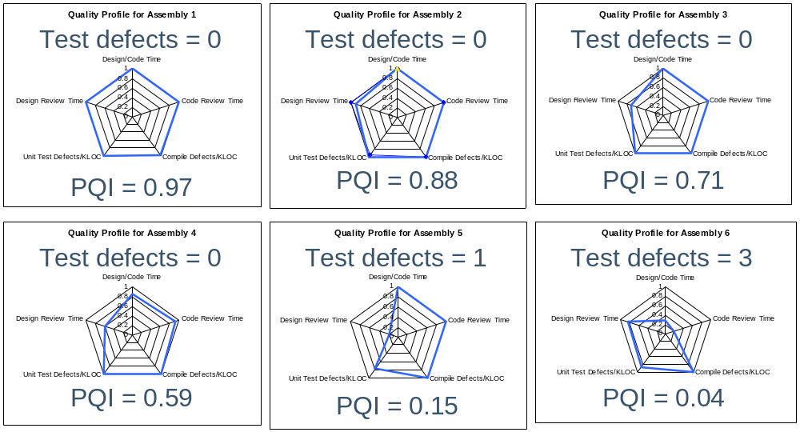
Selected TSP Quality Profiles

Slide 49
Tracking and Reporting Progress
Managers always have questions and the less they know, the more they ask.
Is the team falling behind?
Is everybody working hard?
Will they meet the next milestone?
What can I do to keep them on schedule?
What can I tell senior management about project status?
To be a self-directed team, you need management’s trust.
To keep management’s trust, answer these questions before they think to ask them.
This takes data, analysis, and regular reporting.

Slide 50
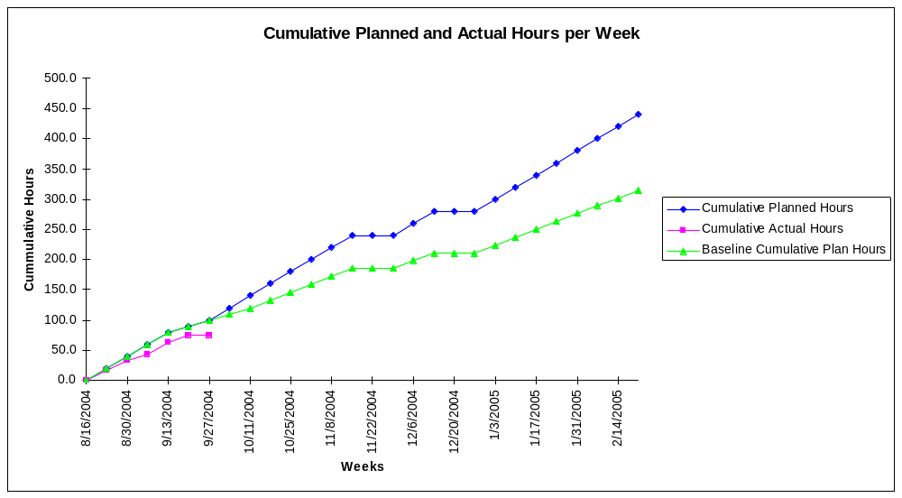
Project Progress Indicators
Inadequate working hours per week is often an early sign that the team is falling behind and needs management help.

Slide 51
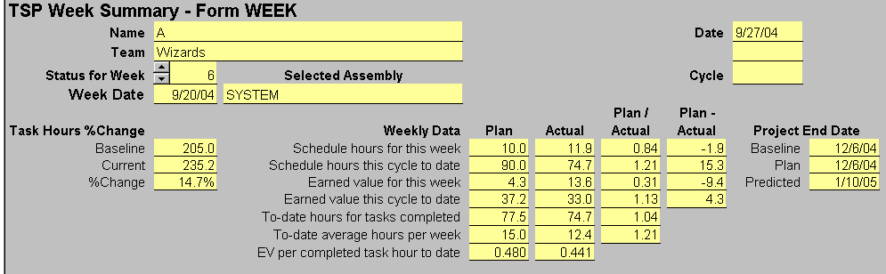
Weekly Team Data
TSP teams review their status, progress, and plans every week.
The weekly summary report provides all the data needed to precisely determine project status and rate of progress.
These data provide the information you need for management reporting.

Slide 52
Demonstrate Performance
Good work is satisfying, profitable, and fun but it is also invisible.
Today, most development organizations use crisis management.
They typically work on the crises and ignore everything else.
With the TSP, you will rarely have crises and never have schedule surprises.
Unless you regularly advertise your successes, your work will not be noticed and you will lose management support.

Slide 53
The Next Steps
Once you complete the PSP for Engineers course, you are qualified to be a TSP team member.
You may also train to be an authorized PSP instructor and TSP coach.

Slide 54
PSP Instructor Training
The SEI PSP Instructor Training course teaches you to teach the PSP and TSP courses.
  the TSP executive seminar
  TSP management training
  the personal process course
  the PSP I and PSP II engineering courses
As an authorized PSP instructor, you can become licensed to use the SEI course materials.
You are also required to provide student data and course evaluations for each course you teach.

Slide 55
Instructor Training Requirements
Entry criteria
  complete a written pre-test (open-book)
  submit your PSP student data to the SEI for screening to ensure that you have a basic understanding of the PSP
  previous teaching or public speaking experience
Take the five-day training course at the SEI within eighteen months of completing the PSP for Engineers course.
  present your PSP data and a case study
  pass a qualification exam (closed-book)

Slide 56
Coach Training Purpose
The SEI TSP Coach Training teaches you to coach TSP teams.
It is a five-day course taught at the SEI.
To attend you must
  be an SEI-authorized PSP instructor
  have a TSP license agreement between your organization and CMU
To qualify as a TSP coach, SEI must observe you successfully launch a TSP team.

Slide 57
PSP Certification
As a certified PSP professional, you will have recognized evidence of your professional competence in software engineering.
This will make you more attractive as a potential employee and add to your professional stature.
To find out more about the PSP certification process, contact the SEI.

Slide 58
Concluding Comments
With PSP training, you now have the skills and knowledge to do superior software engineering.
With these skills come responsibilities.
To fulfill these responsibilities, it is helpful to consider your personal goals.

Slide 59
The Responsible Professional
As a responsible professional, you need to
  find and learn new methods
  use these methods in your work
  recognize your strengths and weaknesses
  identify areas for improvement
  practice, practice, practice
  publicize the methods that you find helpful
  learn from history
This will assure your continuing professional growth and improvement.

Slide 60
What Do You Want from Software Engineering?
What are your personal objectives?
Surprisingly often, we achieve our objectives in ways that we did not expect, so keep an open mind and keep looking.
Since we all reach the same end, we should concentrate on the route.
If you can occasionally achieve excellence, it could be well worth the trip.

